Slide 1


Forma AI - Explanatory Analysis
Ankur Kumar

Slide 2
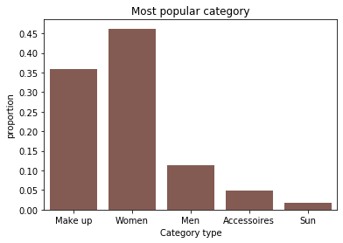
Categories
Target market – ‘Women’
'Women' category is close to 50% of purchases, hence it is the most popular item that people like to buy. Couple with ‘Make Up’ items, these 2 categories are dominant selling products.
'Men', 'Accessories', and 'Sun' are not doing well. 'Accessories' and 'Sun' make up only 5% of the sales. These products needs to be reconsidered.
Opportunity – Categories which are not doing well can be revised and items can we omitted from the inventory.

Slide 3
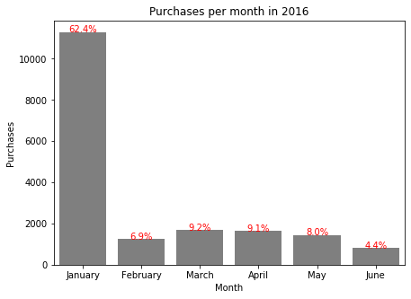
Sales throughout the year
In the given data frame, January (62.4%) was the most profitable month of the year 2016. I am assuming there is a new year sale in this month.
March - May seems to be consistent with sales.
Lowest number of sales in June (4.4%).
Opportunity – Company can boost sales if more sale opportunists are held in the year.

Slide 4
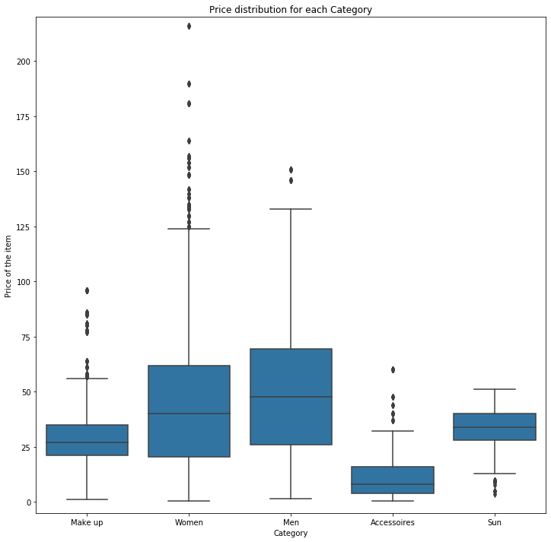
Price Distribution in Categories
High variance is seen in 'Women' followed by 'Men' category. Hence, 'Women' has the most expensive items present in the inventory.
Central Line in each plot shows indicates the median of the distribution. Top and bottom line represents the third and first quartile of the price, respectively.
Max range is set by whisker length. Although, we can see points above the highest whisker in 'Make up', 'Women', 'Men', and 'Accessories' category. This indicates there are many outliers for these categories which are higher than the third quartile.
Opportunity – Seems people are interested in buying expensive items, more options can be added to give more choices to improve customer satisfaction.

Slide 5
Other Data Insights:
There are large number of ‘Loyal’ customers who have not been categorized as VIP. Incentives can be provided to the Loyal customers to lure them to VIP section.
Customer 8662377 has the most transactions in the system.
Few 'New' segments of customers are introduced in year of 2016. Looks like company is not interested in bringing new consumers or the efforts are not up to the mark.
There is a huge catalog for brand presented by the company. Selling ’22’ different brands across various categories.
The customers prefer to buy items whose price falls under a specific range.
Brand 'C' is very popular amongst the top 2 categories.
Active Segments can be utilized more to understand the behavior of customers, it's not being used efficiently. The active flag has been set to 'N' for:
- 3652 VIP customers
- 2793 LOYAL customers

